Slide 2
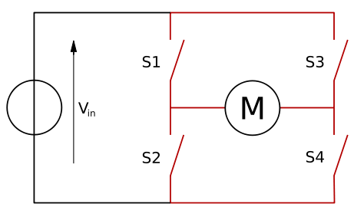
H-Bridge (Motor Driver)

